Slide 1
Confidence Interval Estimates
CHAPTER 6

Slide 2
Learning Objectives (1 of 2)
Define point estimate, standard error, confidence level, and margin of error
Compare and contrast standard error and margin of error
Compute and interpret confidence intervals for means and proportions
Differentiate independent and matched or paired samples

Slide 3
Learning Objectives (1 of 2)
Compute confidence intervals for the difference in means and proportions in independent samples and for the mean difference in paired samples
Identify the appropriate confidence interval formula based on type of outcome variable and number of samples

Slide 4
Statistical Inference (1 of 2)
There are two broad areas of statistical inference: estimation and hypothesis testing.
Estimation—the population parameter is unknown, and sample statistics are used to generate estimates of the unknown parameter.

Slide 5
Statistical Inference (2 of 2)
Hypothesis testing—an explicit statement or hypothesis is generated about the population parameter; sample statistics are analyzed and determined to either support or reject the hypothesis about the parameter.
In both estimation and hypothesis testing, it is assumed that the sample drawn from the population is a random sample.

Slide 6
Estimation (1 of 2)
Process of determining likely values for unknown population parameter
Point estimate is best single-valued estimate for parameter.
Confidence interval is range of values for parameter.
point estimate ± margin of error

Slide 7
Estimation (2 of 2)
A point estimate for a population parameter is the “best” single number estimate of that parameter.
A confidence interval estimate is a range of values for the population parameter with a level of confidence attached (e.g., 95% confidence that the range or interval contains the parameter).

Slide 8
Confidence Interval Estimates
point estimate ± margin of error
point estimate ± Z SE (point estimate)
where Z = value from standard normal distribution for desired confidence level and SE (point estimate) = standard error of the point estimate

Slide 9
Confidence Intervals for μ
Continuous outcome
One sample
n ≥ 30 (Find Z in Table 1B)
n < 30 (Find t in Table 2 [next slide], df = n – 1)

Slide 10
Table 2. Critical Values of the t Distribution
Table entries represent values from t distribution with upper tail area equal to α.
Confidence level 80% 90% 95% 98% 99%
Two-sided test a .20 .10 .05 .02 .01
One-sided test a .10 .05 .025 .01 .005
df
1 3.078 6.314 12.71 31.82 63.66
2 1.886 2.920 4.303 6.965 9.925
3 1.638 2.353 3.182 4.541 5.841
4 1.533 2.132 2.776 3.747 4.604
5 1.476 2.015 2.571 3.365 4.032
6 1.440 1.943 2.447 3.143 3.707
7 1.415 1.895 2.365 2.998 3.499
8 1.397 1.860 2.306 2.896 3.355
9 1.383 1.833 2.262 2.821 3.250
10 1.372 1.812 2.228 2.764 3.169

Slide 11
Example 6.1. Confidence Interval for μ (1 of 2)
In the Framingham Offspring Study (n = 3534), the mean systolic blood pressure (SBP) was 127.3 with a standard deviation of 19.0.
Generate a 95% confidence interval for the true mean SBP.
127.3 ± 0.63
(126.7, 127.9)

Slide 12
Example 6.2. Confidence Interval for μ (2 of 2)
In a subset of n = 10 participants attending the Framingham Offspring Study, the mean SBP was 121.2 with a standard deviation of 11.1.
Generate a 95% confidence interval for the true mean SBP.
df = n – 1 = 9, t = 2.262
121.2 ± 7.94
(113.3, 129.1)

Slide 13
New Scenario
Outcome is dichotomous (p = population proportion)
Result of surgery (success, failure)
Cancer remission (yes/no)
One study sample
Data
On each participant, measure outcome (yes/no)
n, x = number of positive responses

Slide 14
Confidence Intervals for p
Dichotomous outcome
One sample
(Find Z in Table 1B)

Slide 15
Example 6.3. Confidence Interval for p
In the Framingham Offspring Study (n = 3532), 1219 patients were on antihypertensive medications.
Generate a 95% confidence interval for the true proportion on antihypertensive medication.
0.345 ± 0.016
(0.329, 0.361)

Slide 16
New Scenario
Outcome is continuous
SBP, weight, cholesterol
Two independent study samples
Data
On each participant, identify group and measure outcome

Slide 17
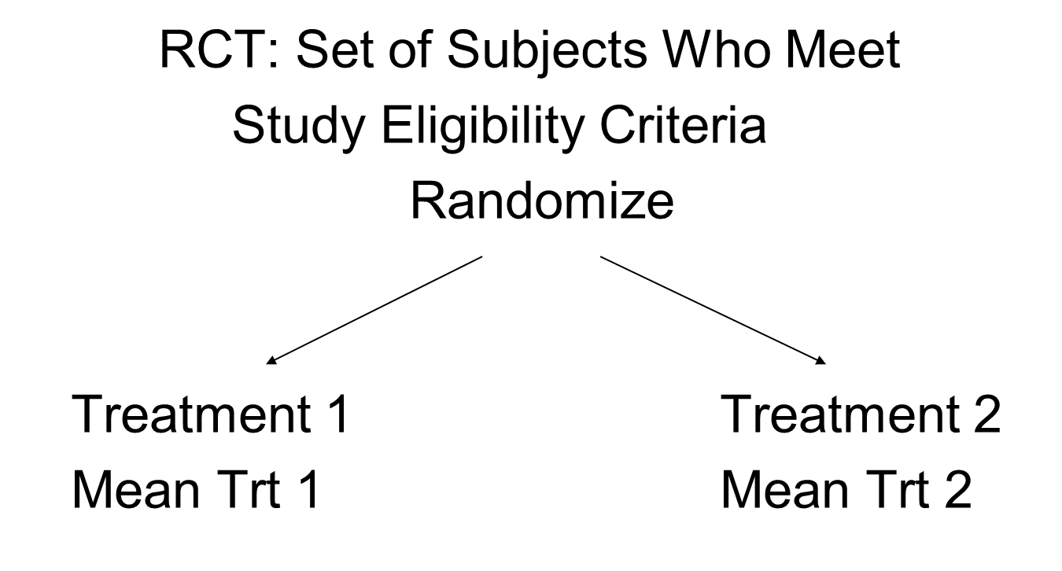
Two Independent Samples (1 of 2)

Slide 18
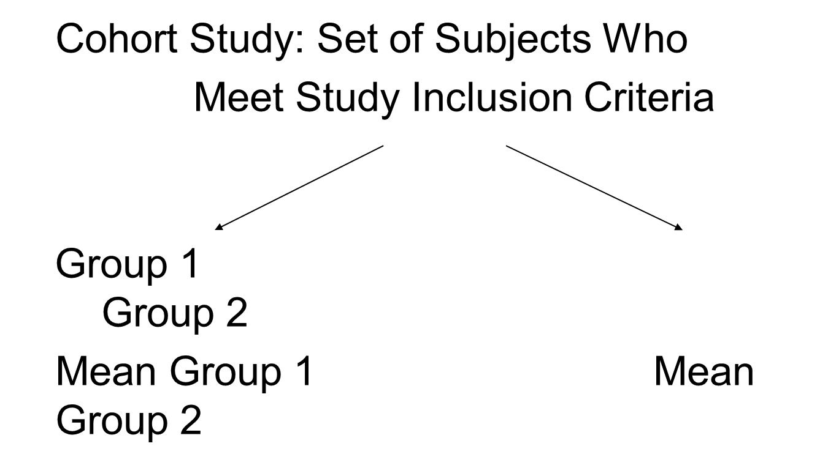
Two Independent Samples (2 of 2)

Slide 19
Confidence Intervals for (μ₁ − μ₂)
Continuous outcome
Two independent samples
n₁ ≥ 30
and n₂ ≥ 30 (Find Z in
Table 1B)
n₁ < 30
or n₂ < 30 (Find t in
Table 2,
df = n₁ + n₂ – 2)

Slide 20
Pooled Estimate of Common Standard Deviation, Sp
Previous formulas assume equal variances (σ₁² = σ₂²)
If 0.5 ≤ s₁²/s₂² ≤ 2, assumption is reasonable

Slide 21
Example 6.5. Confidence Interval for (μ₁ − μ₂)
Using data collected in the Framingham Offspring Study, generate a 95% confidence interval for the difference in mean SBP between men and women.
n Mean Std Dev
Men 1623 128.2 17.5
Women 1911 126.5 20.1

Slide 22
Assess Equality of Variances
Ratio of sample variances: 17.5²/20.1² = 0.76

Slide 23
Confidence Intervals for (μ₁ − μ₂)
1.7 ± 1.26
(0.44, 2.96)

Slide 24
New Scenario
Outcome is continuous
SBP, weight, cholesterol
Two matched study samples
Data
On each participant, measure outcome under each experimental condition.
Compute differences (D = X₁ – X₂)

Slide 25
Two Dependent/Matched Samples
Subject ID Measure 1 Measure 2
1 55 70
2 42 60
.
.
Measures taken serially in time or under different experimental conditions

Slide 26
Crossover Trial
Treatment Treatment
Eligible R
Participants
Placebo Placebo
Each participant measured on treatment and placebo

Slide 27
Confidence Intervals for μ_{d}
Continuous outcome
Two matched/paired samples
n ≥ 30 (Find Z in Table 1B)
n < 30 (Find t in Table 2,
df = n – 1)

Slide 28
Example 6.8. Confidence Interval for μ_{d} (1 of 3)
In a crossover trial to evaluate a new medication for depressive symptoms, patients’ depressive symptoms were measured after taking new drug and after taking placebo.
Depressive symptoms were measured on a scale of 0 to100 with higher scores indicative of more symptoms.

Slide 29
Example 6.8. Confidence Interval for μ_{d} (2 of 3)
Construct a 95% confidence interval for the mean difference in depressive symptoms between drug and placebo.
The mean difference in the sample (n = 100) is –12.7 with a standard deviation of 8.9.

Slide 30
Example 6.8. Confidence Interval for μ_{d} (3 of 3)
–12.7 ± 1.74
(–14.1, –10.7)

Slide 31
New Scenario
Outcome is dichotomous
Result of surgery (success, failure)
Cancer remission (yes/no)
Two independent study samples
Data
On each participant, identify group and measure outcome (yes/no)

Slide 32
Confidence Intervals for (p₁ − p₂)
Dichotomous outcome
Two independent samples
(Find Z in Table 1B)

Slide 33
Example 6.10. Confidence Interval for (p₁ – p₂) (1 of 3)
A clinical trial compares a new pain reliever to that considered standard care in patients undergoing joint replacement surgery; the outcome of interest is reduction in pain by 3+ scale points.
Construct a 95% confidence interval for the difference in proportions of patients reporting a reduction between treatments.

Slide 34
Example 6.10. Confidence Interval for (p₁ – p₂) (2 of 3)
Reduction of 3+ Points
Treatment n Number Proportion
New 50 23 0.46
Standard 50 11 0.22

Slide 35
Example 6.10. Confidence Interval for (p₁ – p₂) (3 of 3)
0.24 ± 0.18
(0.06, 0.42)

Slide 36
Confidence Intervals for Relative Risk (RR)
Dichotomous outcome
Two independent samples
exp(lower limit), exp(upper limit)
(Find Z in Table 1B)

Slide 37
Example 6.12. Confidence Interval for RR (1 of 2)
Reduction of 3+ Points
Treatment n Number Proportion
New 50 23 0.46
Standard 50 11 0.22
Construct a 95% CI for the relative risk.

Slide 38
Example 6.12. Confidence Interval for RR (2 of 2)
0.737 ± 0.602 exp(0.135), exp(1.339)
(0.135, 1.339) (1.14, 3.82)

Slide 39
Confidence Intervals for Odds Ratio (OR)
Dichotomous outcome
Two independent samples
exp(lower limit), exp(upper limit)
(Find Z in Table 1B)

Slide 40
Example 6.14. Confidence Interval for OR (1 of 2)
Reduction of 3+ Points
Treatment n Number Proportion
New 50 23 0.46
Standard 50 11 0.22
Construct a 95% CI for the odds ratio.

Slide 41
Example 6.14. Confidence Interval for OR (2 of 2)
1.105 ± 0.870 exp(0.235), exp(1.975)
(0.235, 1.975) (1.26, 7.21)

